Slide 1
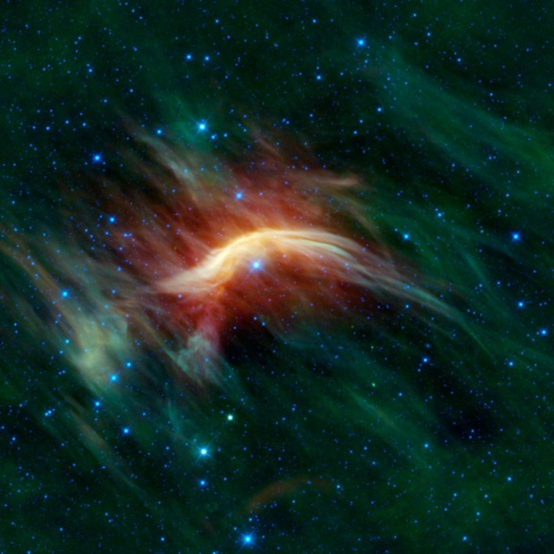
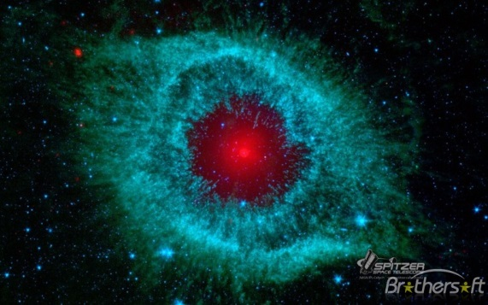
A Common
Mission Language

Slide 2
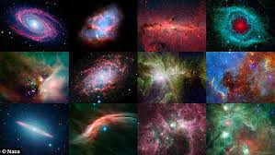
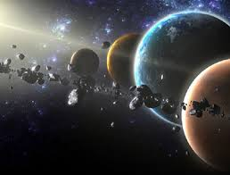
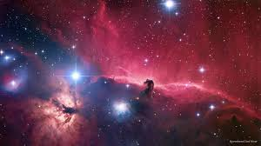
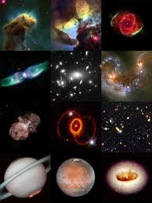
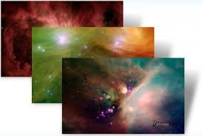
CHARISM
MISSION
MINISTRY
MINISTRIES
(works of service)
SPONSORED
CSJ MISSION
NETWORK
The Call to Mission

Slide 3
A Word by Emily Dickinson
A word is dead
when it is said
some say.
I say it just begins
to live
that day.

Slide 4
Language of the Heart/Art

Slide 5
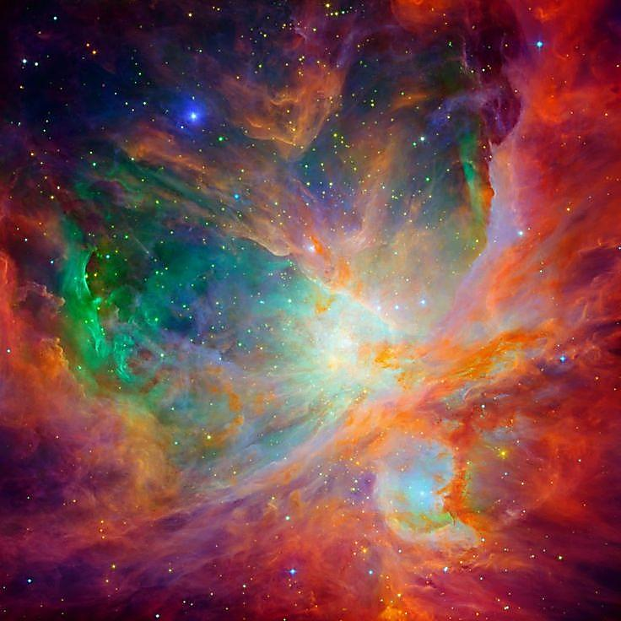
CHARISM
God-given gift or grace
impels us from the INSIDE
to live the mission
in service to the common good
UNITY
The Call to Mission

Slide 6
MISSION
Our purpose and goal
The Charism made manifest
why we exist
The Call to Mission

Slide 7
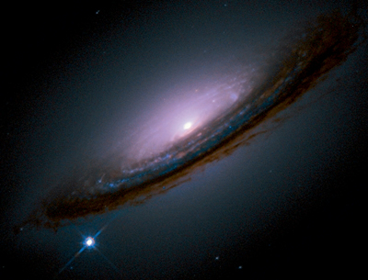
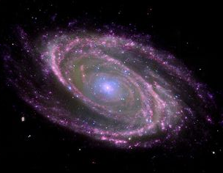
UNITY
to live and work to bring all into union
with God and with one another
to live and work that all may be one
to draw all into one
to live and be communion
to do the work of unioning love
The Call to Mission

Slide 8
Our Mission: fostering union
God . . . ourselves
2. neighbor with neighbor
3. neighbor with God
The Call to Mission

Slide 9
Union with God and neighbor:
one interwoven movement
The Call to Mission

Slide 10
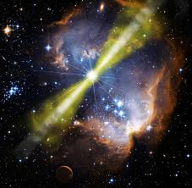
Ministry:
How I live out the mission
About being in relationship
the quality of our presence . . .
our manner of relating
The Call to Mission

Slide 11
How I further the mission of Unity
Quality of your PRESENCE
Your manner of RELATING
Conscious and Intentional
With every kind of neighbor and Earth herself

Slide 12
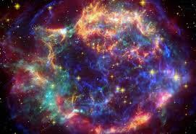
“Every kind of neighbor . . .
without distinction”
The Call to Mission

Slide 13
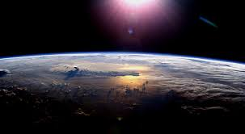
In and through the ordinary
day by day . . . person by person
The Call to Mission

Slide 14
CHARISM
MISSION
MINISTRY
MINISTRIES
(works of service)
SPONSORED
CSJ MISSION
NETWORK
The Call to Mission

Slide 15
impelled by the tradition
What about this mission resonates most with me personally or attracts me the most? Why?
What about this mission challenges me? Why?
What else do I want to say?

Slide 16
impelled by the tradition
For Large Group Sharing
As we reflect on this mission of unity together, what is happening in my head? In my heart?
What am I/what are we experiencing
in our table group?

